Slide 1
Network Layer:
Logical Addressing
(IP Addressing )

Slide 2
IPv4 ADDRESSES
An IPv4 address is a 32-bit address that uniquely and universally defines the connection of a device (for example, a computer or a router) to the Internet.

Slide 3
The address space of IPv4 is 2³² or 4,294,967,296.
Ideally, every smart device connected to internet should have an IP address in the following address space
0
1
2
1000
1001
1002
4,294,967,296

Slide 4
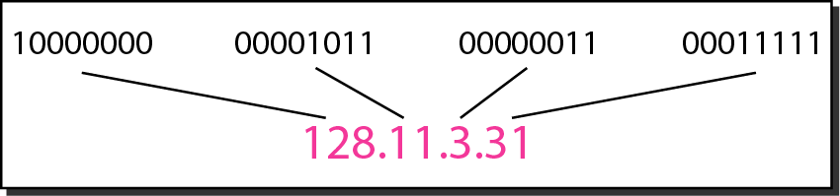
Dotted-decimal notation and binary notation for an IPv4 address

Slide 5
Universal IP address space in dotted decimal notation
0.0.0.0
0.0.0.1
100.100.100.100
255.255.255.255

Slide 6
Example 19.1
Change the following IPv4 addresses from binary notation to dotted-decimal notation.
Solution
We replace each group of 8 bits with its equivalent decimal number (see Appendix B) and add dots for separation.

Slide 7
Example 19.2
Change the following IPv4 addresses from dotted-decimal notation to binary notation.
Solution
We replace each decimal number with its binary equivalent (see Appendix B).

Slide 8
Example 19.3
Find the error, if any, in the following IPv4 addresses.
Solution
a. There must be no leading zero (045).
b. There can be no more than four numbers.
c. Each number needs to be less than or equal to 255.
d. A mixture of binary notation and dotted-decimal notation is not allowed.

Slide 9
Two ways of IP addressing
1) Classfull addressing ( Past )
2) Classless addressing ( Present )
Worldwide internet is divided in to multiple networks. Every computer / host connected to internet must be attached to one of these networks. Every network has an identification

Slide 10
Classfull address principle – Internet is divided in to different sized networks – Large (A), Medium(B) & Small(C)
B
B
A
A
A
A
B
B
C
C

Slide 11

Note
In classful addressing, the address space is divided into five classes:
A, B, C, D, and E.

Slide 12
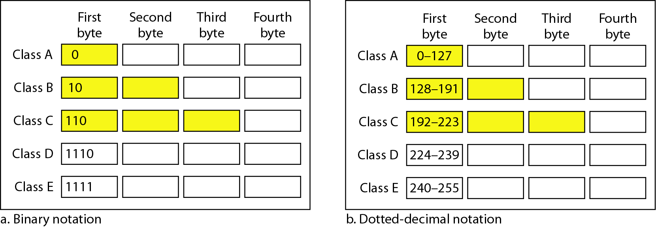
Figure 19.2 Finding the classes in binary and dotted-decimal notation

Slide 13
Any network is characterized by the following 4 parameters :
Net ID or Subnet ID
Total number of addresses in that network ( Address space )
First usable address
Last usable address

Slide 14
Example 19.4
Find the class of each address.
a. 00000001 00001011 00001011 11101111
b. 11000001 10000011 00011011 11111111
c. 14.23.120.8
d. 252.5.15.111
Solution
a. The first bit is 0. This is a class A address.
b. The first 2 bits are 1; the third bit is 0. This is a class C address.
c. The first byte is 14; the class is A.
d. The first byte is 252; the class is E.

Slide 15
Table 19.1 Number of blocks and block size in classful IPv4 addressing

Slide 16
Concept of Network Mask or Subnet Mask
Whenever a host connected to internet is to be identified or configured, 2 numbers are used
IP Address
Network mask or subnet mask
Table 19.2 Default masks for classful addressing
Network mask or subnet mask is used to find out the network id or subnet id to which a host belongs to.

Slide 17
Disadvantage of Class full addressing
In classful addressing, a large part of the available addresses were wasted.

Slide 18
Note
Classful addressing, which is almost obsolete, is replaced with classless addressing.

Slide 19
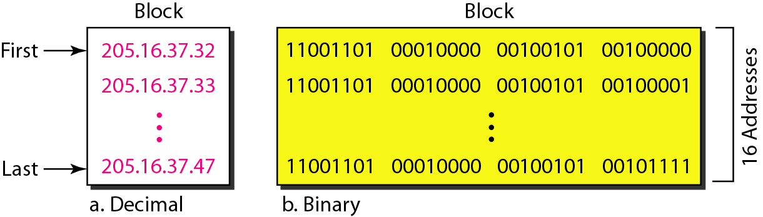
Classless address Concept
Example : A block of 16 addresses granted to a small organization

Slide 20
Note
In IPv4 classless addressing, a block of addresses can be defined as
x.y.z.t /n
in which x.y.z.t defines one of the addresses and the /n defines the mask.

Slide 21
Note
The first address in the block can be found by setting the rightmost 32 − n bits to 0s.

Slide 22
Example 19.6
A block of addresses is granted to a small organization. We know that one of the addresses is 205.16.37.39/28. What is the first address in the block?
Solution
The binary representation of the given address is
11001101 00010000 00100101 00100111
If we set 32−28 rightmost bits to 0, we get
11001101 00010000 00100101 0010000
or 205.16.37.32.
This is actually the block shown in Figure 19.3.

Slide 23
Note
The last address in the block can be found by setting the rightmost 32 − n bits to 1s.

Slide 24
Example 19.7
Find the last address for the block in Example 19.6.
Solution
The binary representation of the given address is
11001101 00010000 00100101 00100111
If we set 32 − 28 rightmost bits to 1, we get
11001101 00010000 00100101 00101111
or
205.16.37.47
This is actually the block shown in Figure 19.3.

Slide 25
Example 19.9 (continued)
Solution
a. The first address can be found by ANDing the given addresses with the mask. ANDing here is done bit by bit. The result of ANDing 2 bits is 1 if both bits are 1s; the result is 0 otherwise.

Slide 26
Example 19.9 (continued)
b. The last address can be found by ORing the given addresses with the complement of the mask. ORing here is done bit by bit. The result of ORing 2 bits is 0 if both bits are 0s; the result is 1 otherwise. The complement of a number is found by changing each 1 to 0 and each 0 to 1.

Slide 27
Example 19.9 (continued)
c. The number of addresses can be found by complementing the mask, interpreting it as a decimal number, and adding 1 to it.

Slide 28
Figure 19.4 A network configuration for the block 205.16.37.32/28

Slide 29
‘Rules’ of IP addressing
The first address in a block /subnet is normally not assigned to any device; it is used as the network address that represents the organization to the rest of the world.
The Last address in a block is normally not assigned to any device; it is used as a special address to broadcast a packet to all the hosts in that subnet
So, total number of usable addresses in a subnet is always total number of addresses available – 2
For example in a clasfull addressing, in class C, only 254 addresses can be used to configure hosts.

Slide 30
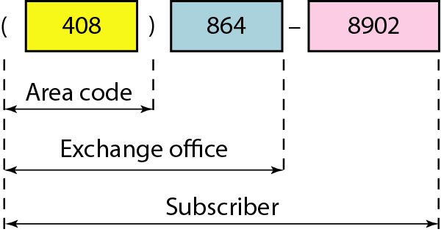
Figure 19.5 Two levels of hierarchy in an IPv4 address

Slide 31
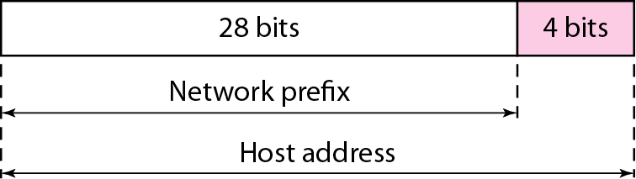

Slide 32
Note
Each address in the block can be considered as a two-level hierarchical structure: the leftmost n bits (prefix) define the network;
the rightmost 32 − n bits define the host.

Slide 33
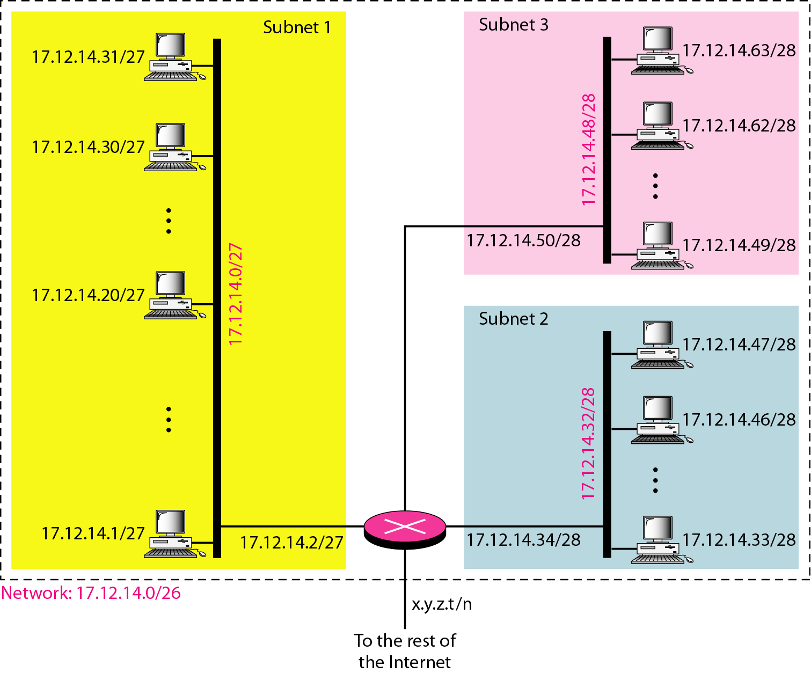
Figure 19.7 Configuration and addresses in a subnetted network

Slide 34
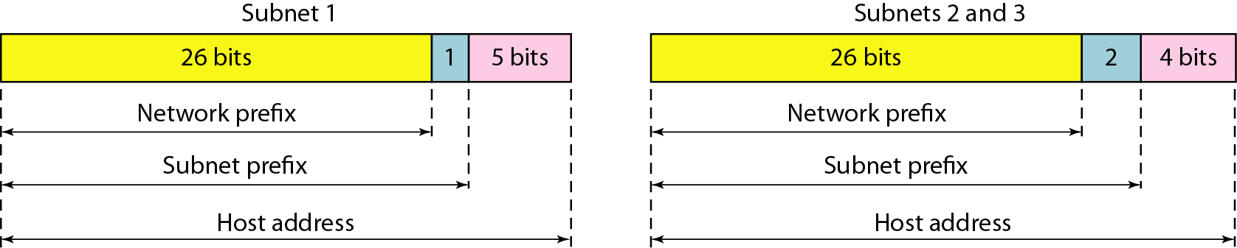
Figure 19.8 Three-level hierarchy in an IPv4 address

Slide 35
Example 19.10
An ISP is granted a block of addresses starting with 190.100.0.0/16 (65,536 addresses). The ISP needs to distribute these addresses to three groups of customers as follows:
a. The first group has 64 customers; each needs 256 addresses.
b. The second group has 128 customers; each needs 128 addresses.
c. The third group has 128 customers; each needs 64 addresses.
Design the subblocks and find out how many addresses are still available after these allocations.

Slide 36
Example 19.10 (continued)
Solution
Figure 19.9 shows the situation.
Group 1
For this group, each customer needs 256 addresses. This means that 8 (log2 256) bits are needed to define each host. The prefix length is then 32 − 8 = 24. The addresses are

Slide 37
Example 19.10 (continued)
Group 2
For this group, each customer needs 128 addresses. This means that 7 (log2 128) bits are needed to define each host. The prefix length is then 32 − 7 = 25. The addresses are

Slide 38
Example 19.10 (continued)
Group 3
For this group, each customer needs 64 addresses. This means that 6 (log₂64) bits are needed to each host. The prefix length is then 32 − 6 = 26. The addresses are
Number of granted addresses to the ISP: 65,536
Number of allocated addresses by the ISP: 40,960
Number of available addresses: 24,576

Slide 39
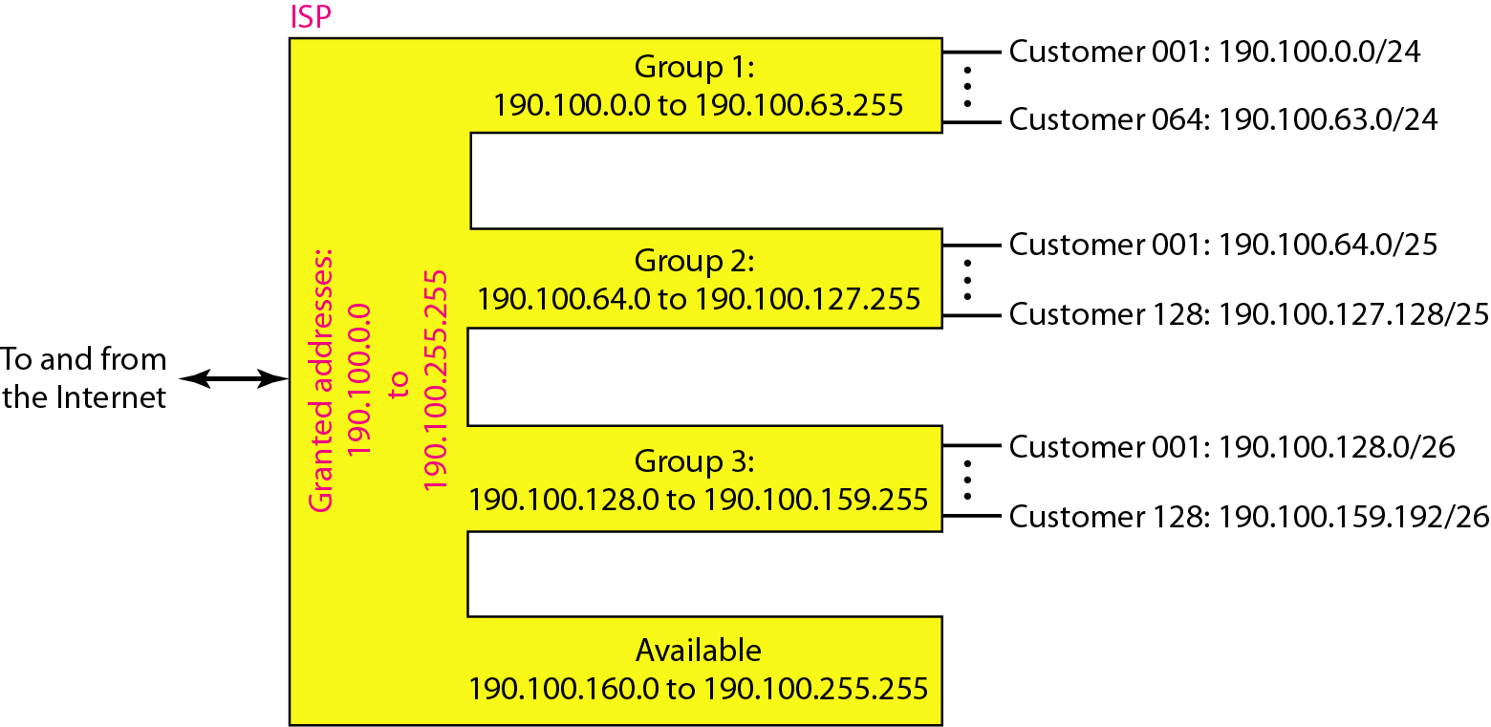
Figure 19.9 An example of address allocation and distribution by an ISP

Slide 40
???
IPV4 addressing - Major challenge for the technologists :
Only 4 billion addresses are available ; But number of hosts/gadgets to be connected is more than 4 billion
How to manage the demand and supply problem
???

Slide 41
Temporary ( Ad-hoc solutions)
Permanent Solution
1.Classless Addressing
IPV6
2. DHCP
3.NAT

